Slide 1
A 4.6GHz 162Mb SRAM Design in 22nm Tri-Gate CMOS Technology with Integrated Active VMIN-Enhancing Assist Circuitry
Manny Xu CKT
20180514

Slide 2
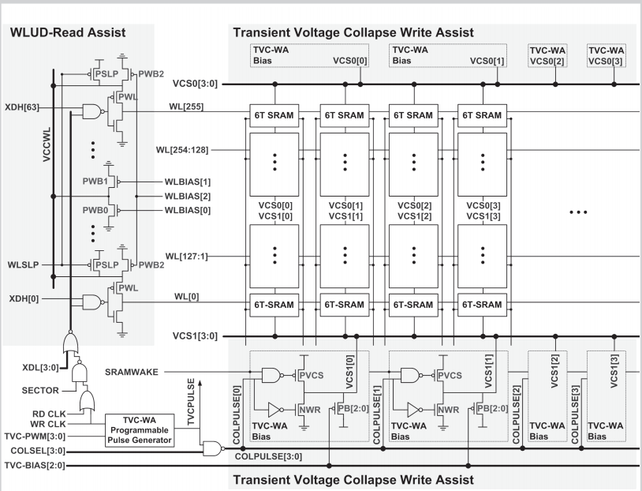
Notes:
针对写buffer

Slide 3
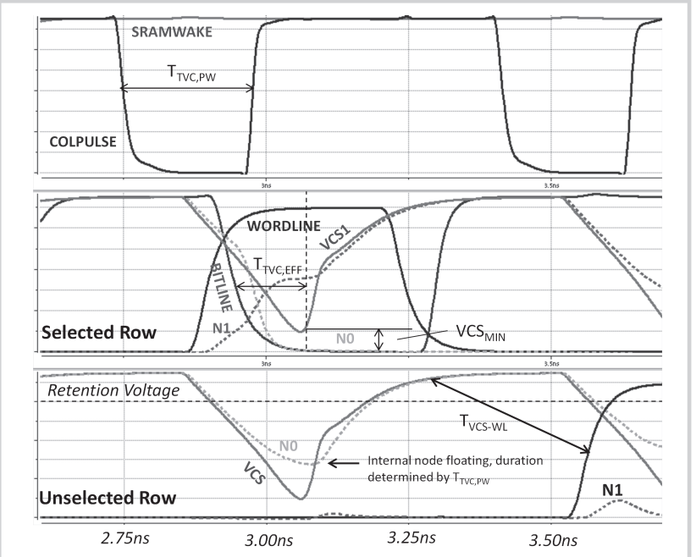
Notes:
针对写buffer

Slide 4
Thank you

